Slide 1

Chandigarh University
Department of Mathematics
B.Tech. CSE (Core/DS/IT/CC)
Semester-3
Subject Code:25MTT-202
Discrete Mathematics
Unit - 5 (Chapter- 5.3.2)
Dr. SARTAJ
DISCOVER . LEARN . EMPOWER

Slide 2

CO mappings

Slide 3

CO-PO mappings
Note: Degree of relevance/correlation: 1-Low, 2-Medium, 3-High, Blank or ‘- ‘- Nil

Slide 4
Topics Overview
Trees, Properties, Spanning Tree and examples
Conclusions
Video links
References

Slide 5
Trees
A tree is a connected undirected graph with no simple circuits, denoted by T.
It consists of nodes (vertices) connected by branches (edges).
A tree with only one vertex is called trivial tree, otherwise a non-trivial tree.
A collection of trees is called a Forest.

Slide 6
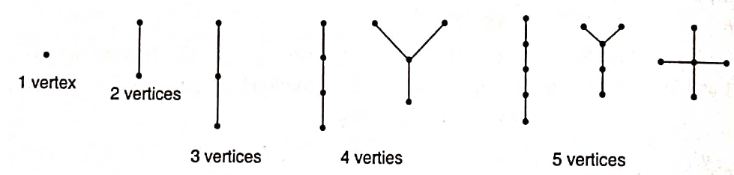
Trees
Examples of Trees:

Slide 7
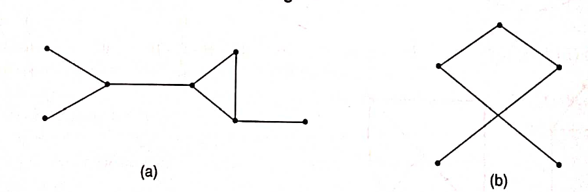
Trees
Examples of graphs which are not trees: (since they have cycles)
Because a tree cannot have a simple circuit, a tree cannot contain multiple edges or loops.
Therefore, any tree must be a simple graph.

Slide 8
Trees
Question:What about graphs containing no simple circuits that are not necessarily connected?
Answer: These graphs are called forests and have the property that each of their connected components is a tree.

Slide 9
Properties of Trees
Properties of Tree:
A graph is a tree if and only if there is exactly one path between every pair of its vertices.
A tree with n vertices has n - 1 edges.
Any connected graph with n vertices and n - 1 edges is a tree.

Slide 10
Properties of Trees
Properties of Tree:
Let G be a graph on n vertices. Then, the following statements are equivalent:
(i) G is a tree.
(ii) G is connected and has n - 1 edges.
(iii) G is acyclic (circuities) and has n - 1 edges.
(iv) There exists exactly one path between every pair of vertices in G.
(v) G is a minimally connected graph.

Slide 11
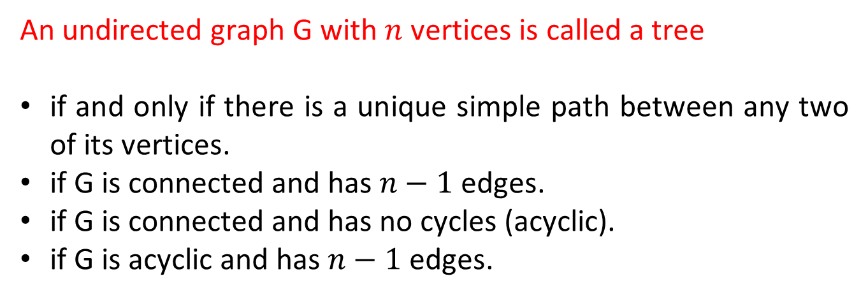
Properties of Trees
An undirected graph G with $n$ vertices is called a tree
if and only if there is a unique simple path between any two of its vertices.
if G is connected and has $n−1$ edges.
if G is connected and has no cycles (acyclic).
if G is acyclic and has $n−1$ edges.

Slide 12
Spanning Tree
Definition of Spanning Tree:
Spanning Tree. A spanning tree of a connected graph G is a tree containing all the vertices of G. A spanning tree of a graph is a maximal tree subgraph of that graph
Note: A spanning tree of a graph G is sometimes called the skeleton or the scaffold graph.

Slide 13
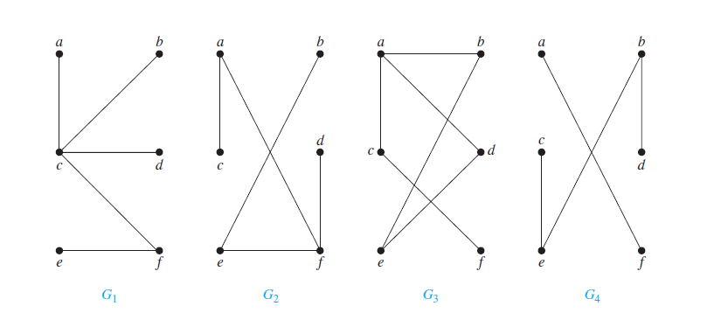
Acticity-1
Questions: Which of the graphs shown below are trees?

Slide 14
Conclusion
Trees, Properties of trees, Spanning tree and related examples are discussed.
In next topic we will discuss its properties.
ns

Slide 15
Video Links
https://youtu.be/P7qBH0dzVX0?si=z2zq0HuI1y_V2QhX
https://youtu.be/kJ_CpAuo79I?si=aTEa7AhbKPU6k6Sr
(Video Links)
https://drive.google.com/file/d/1zm_o2dthNGIi-OXsgP8McUz4SUlb9q3p/view?usp=sharing
(Book Link)

Slide 16
References
Sr. No. | Author | Name of the Book | Publisher | Year of Publication
1 | Kenneth H. Rosen | Discrete Mathematics and Its Applications | McGraw-Hill | 2019
2 | C. L. Liu | Elements of Discrete Mathematics | McGraw-Hill | 1996
3 | J. P. Tremblay, R. Manohar | Discrete Mathematical Structures with Applications to Computer Science | Tata McGraw Hill | 2001
4 | Kolman, Busby, Ross | Discrete Mathematical Structures | PHI | 2001
5 | Narsingh Deo | Graph Theory with Applications to Engineering and | PHI | 2017

Slide 17
Thanks!!!

